Slide 1
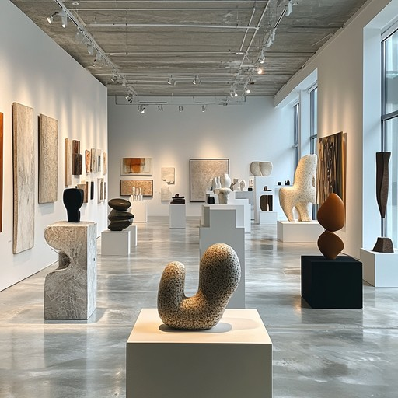
My Original Project Idea
Art gallery with random objects.
I wanted to have a first person point of view and the user can have the ability to walk around and look at all the different objects.
I was going to use light to illuminate all the different objects.
All of the objects were going to have different animations.

Slide 2
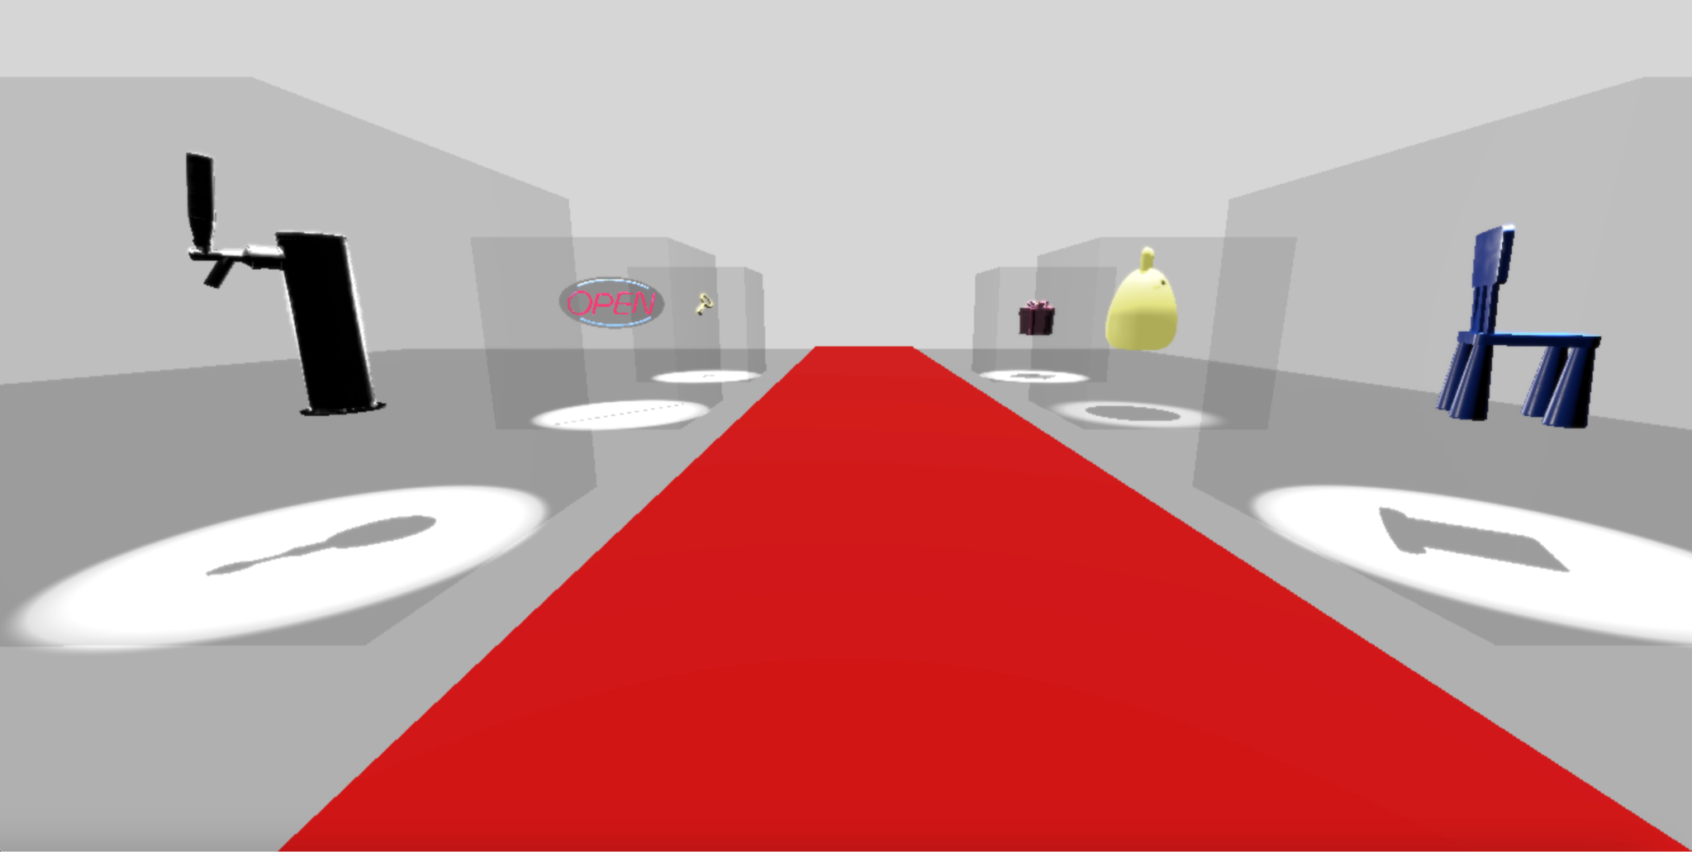
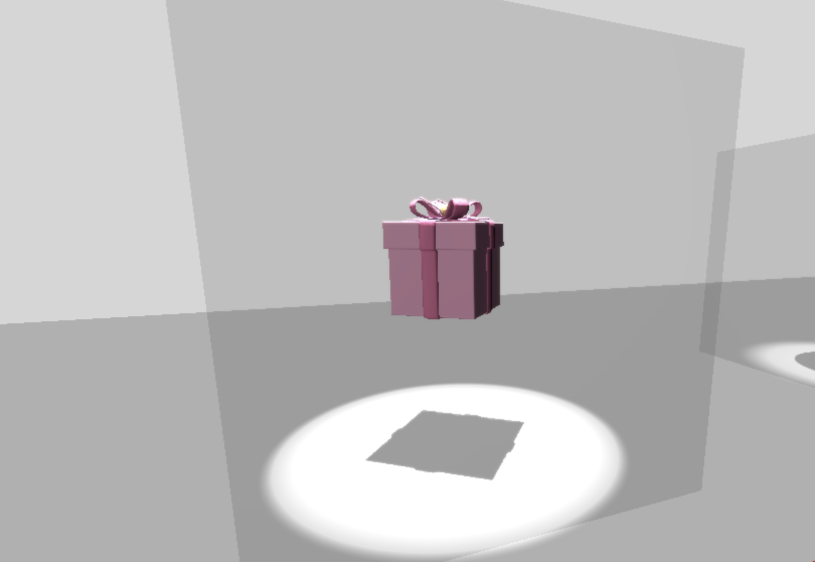
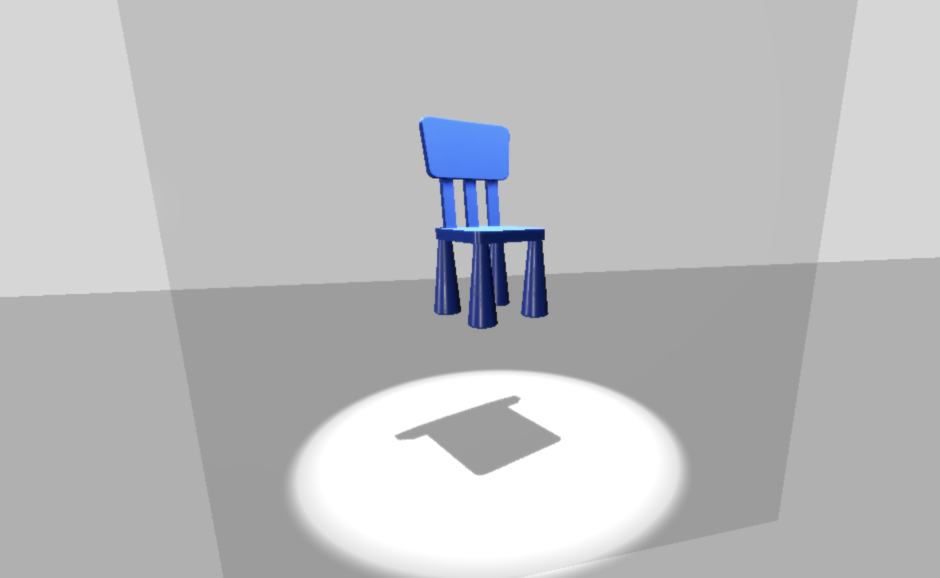
State of Project

Slide 3
Learning Perspectives
Largest Challenge:
Rending the different models.
Using Github.
Coolest Moment:
three.js.

